Slide 1
Network and Communication
Module 6 Quality of Service (QoS) parameters
Dr. S.L.JAYALAKSHMI,
VIT Chennai

Slide 2
Session Outline
Flow characteristics
Techniques to improve QoS
Scheduling
Traffic Shaping
Admission Control
Resource Reservation

Slide 3
Flow Characteristics
Reliability - Reliability is a characteristic that a flow needs. Lack of reliability means losing a packet or acknowledgment, which causes retransmission
Delay - applications can tolerate delay in different degrees.
Jitter - Jitter is the variation in delay for packets belonging to the same flow or Jitter is defined as the variation in the packet delay
Bandwidth - Different applications need different bandwidths.

Slide 4
Techniques to improve QoS
Scheduling
Traffic Shaping
Admission Control
Resource Reservation

Slide 5
Scheduling
Packets from different flows arrive at a switch or router for processing.
A good scheduling technique treats the different flows in a fair and appropriate manner.
FIFO Queuing
Packets wait in a buffer (queue) until the node (router or switch) is ready to process them.
If the average arrival rate is higher than the average processing rate, the queue will fill up and new packets will be discarded

Slide 6
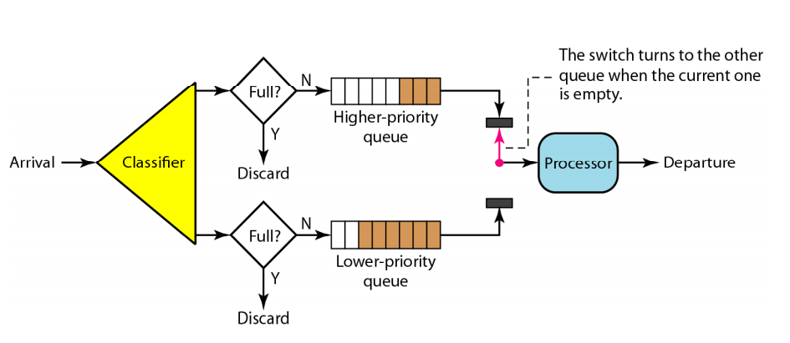
Scheduling
Priority Scheduling
Packets are first assigned to a priority class
Each priority class has its own queue
The packets in the highest-priority queue are processed first.
Packets in the lowest-priority queue are processed last
A priority queue can provide better QoS than the FIFO queue because higher priority traffic, such as multimedia, can reach the destination with less delay
Potential drawback- starvation

Slide 7
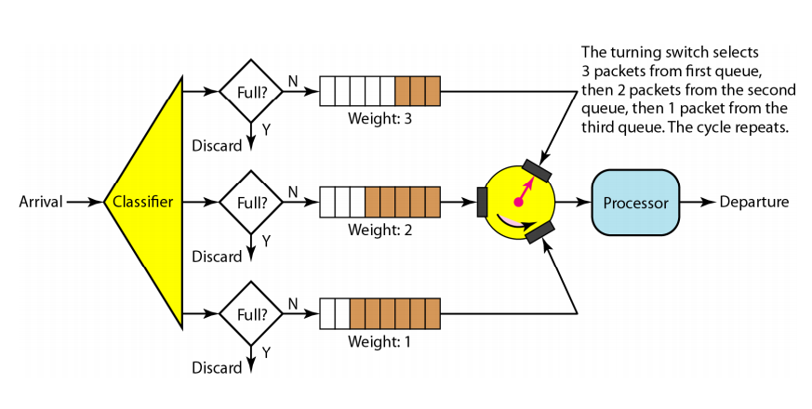
Scheduling
Weighted Fair Queuing
the packets are still assigned to different classes and admitted to different queues.
The queues are weighted based on the priority of the queues; higher priority means a higher weight.
The system processes packets in each queue in a round-robin fashion with the number of packets selected from each queue based on the corresponding weight
For example, if the weights are 3, 2, and 1, three packets are processed from the first queue, two from the second queue, and one from the third queue.

Slide 8
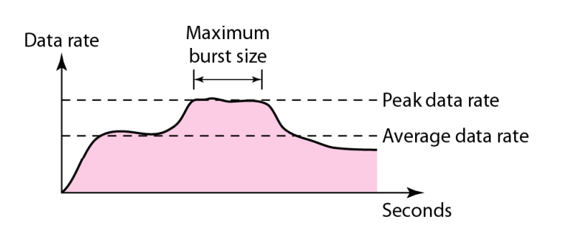

Data traffic
Traffic descriptors-qualitative values that represent a data flow
Peak Data Rate: The peak data rate defines the maximum data rate of the traffic.
Maximum Burst Size: the maximum length of time the traffic is generated at the peak rate.
Eg: If data are flowing steadily at the rate of 1 Mbps with a sudden peak data rate of 2 Mbps for just 1 ms, the network probably can handle the situation. However, if the peak data rate lasts 60 ms, there may be a problem for the network.
Effective Bandwidth: The effective bandwidth is the bandwidth that the network needs to allocate for the flow of traffic.

Slide 9
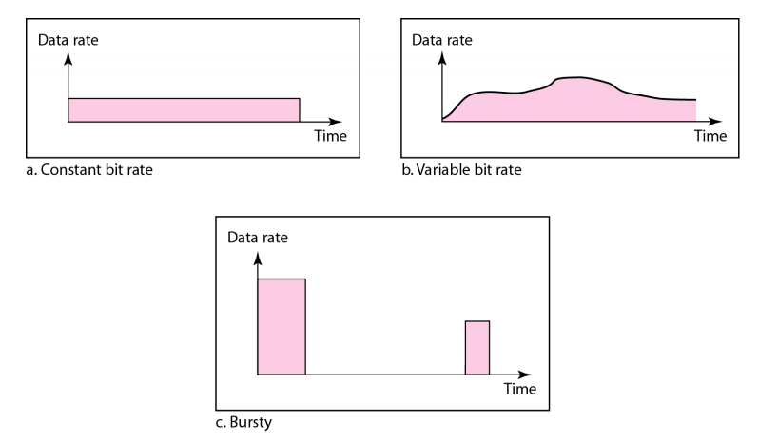
Traffic Profiles

Slide 10
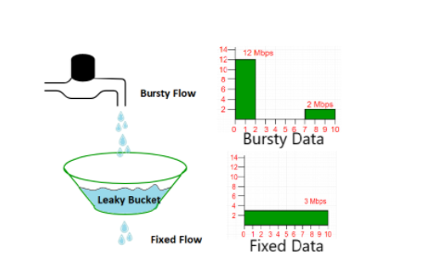
Traffic Shaping
Traffic shaping is a mechanism to control the amount and the rate of the traffic sent to the network. Two techniques can shape traffic: leaky bucket and token bucket.
Leaky Bucket Algorithm
A leaky bucket algorithm shapes bursty traffic into fixed-rate traffic by averaging the data rate. It may drop the packets if the bucket is full.

Slide 11
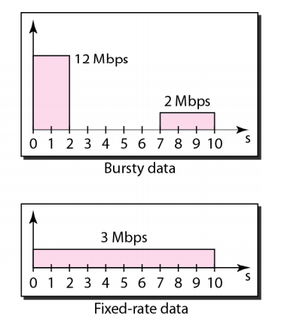
Example 1: Leaky Bucket Algorithm
The host sends a burst of data at a rate of 12 Mbps for 2 s, for a total of 24 Mbits of data.
Average data rate=amount of data /time
12 Mbps=amount of data/2s
12 Mb/s*2s=amount of data
amount of data=24Mbits
The host is silent for 5 s(2secs to 7 sec) and then sends data at a rate of 2 Mbps for 3 s, for a total of 6 Mbits of data.
In all, the host has sent 30 Mbits (24+6)of data in lOs. The leaky bucket smoothen the traffic by sending out data at a rate of 3 Mbps during the same 10 s.
Fixed data rate=Amount of data/time
=30Mbits/10 sec
=3 Mbps

Slide 12
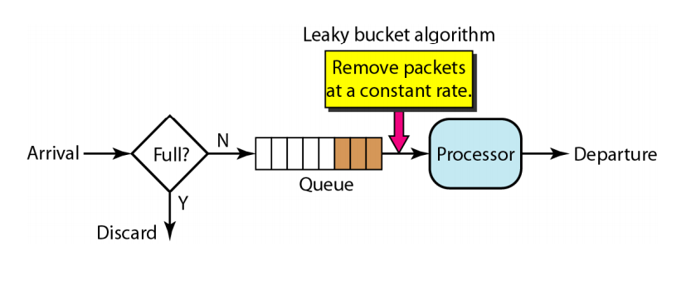
Leaky Bucket Algorithm
A simple leaky bucket algorithm can be implemented using
FIFO queue.
A FIFO queue holds the packets. If the traffic consists of fixed-size packets (e.g., cells in ATM networks), the process removes a fixed number of packets from the queue at each tick of the clock.
If the traffic consists of variable-length packets, the fixed output rate must be based on the number of bytes or bits.
*Source - Data Communication and Networking, Behrouz A. Fourozan, McGraw Hill Education, Fifth Edition, 2012

Slide 13
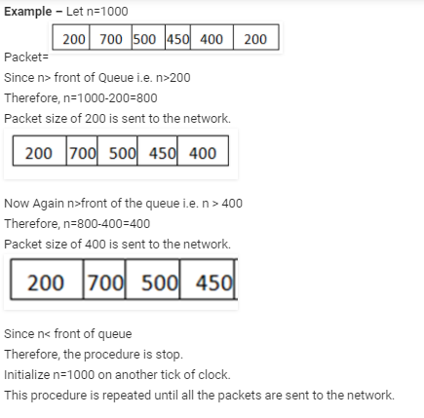
Example 2: Leaky Bucket Algorithm
The following is an algorithm for variable-length packets:
Initialize a counter to n at the tick of the clock.
If n is greater than the size of the packet, send the packet and decrement the counter by the packet size. Repeat this step until n is smaller than the packet size.
Reset the counter and go to step 1.

Slide 14
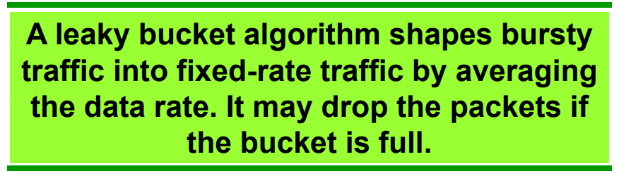

Slide 15
Traffic Shaping
Token bucket algorithm
It allows idle hosts to accumulate credit for the future in the form of tokens.
For each tick of the clock, the system sends n tokens to the bucket.
The system removes one token for every cell (or byte) of data sent.
The token bucket can easily be implemented with a counter.
The token is initialized to zero.
Each time a token is added, the counter is incremented by 1.
Each time a unit of data is sent, the counter is decremented by 1.
When the counter is zero, the host cannot send data
Notes:
The leaky bucket is very restrictive. It does not credit an idle host. For example, if a host is not sending for a while, its bucket becomes empty. Now if the host has bursty data, the leaky bucket allows only an average rate. The time when the host was idle is not taken into account

Slide 16
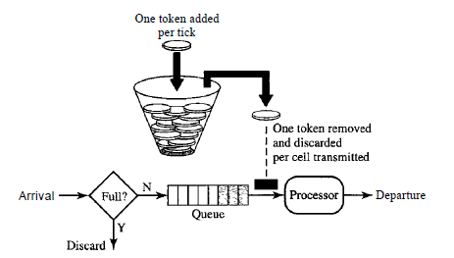
Traffic Shaping
For example, if n is 100 and the host is idle for 100 ticks, the bucket collects 10,000 tokens. Now the host can consume all these tokens in one tick with 10,000 cells, or the host takes 1000 ticks with 10 cells per tick.
In other words, the host can send bursty data as long as the bucket is not empty.
The token bucket allows bursty traffic at a regulated maximum rate.
*Source - Data Communication and Networking, Behrouz A. Fourozan, McGraw Hill Education, Fifth Edition, 2012

Slide 17
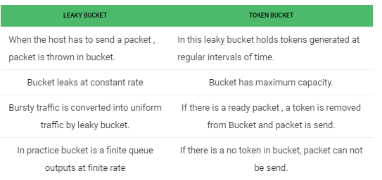
Some advantage of token Bucket over leaky bucket –
If bucket is full in token Bucket , tokens are discard not packets. While in leaky bucket, packets are discarded.
Token Bucket can send Large bursts at a faster rate while leaky bucket always sends packets at constant rate.

Slide 18
Admission Control
Admission control refers to the mechanism used by a router, or a switch, to accept or reject a flow based on predefined parameters called flow specifications.
Before a router accepts a flow for processing, it checks the flow specifications to see if its capacity (in terms of bandwidth, buffer size, CPU speed, etc.) and its previous commitments to other flows can handle the new flow.

Slide 19
Resource Reservation
A flow of data needs resources such as a buffer, bandwidth, CPU time, and so on.
The quality of service is improved if these resources are reserved beforehand.

Slide 20
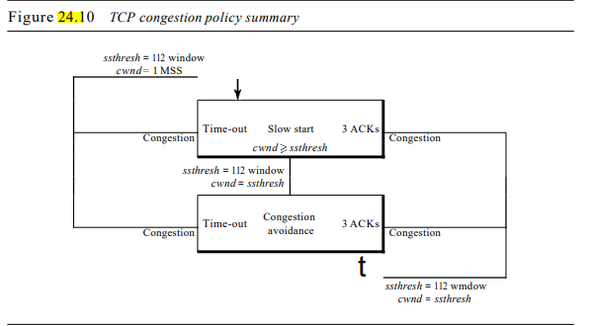
TCP CONGESTION POLICY SUMMARY

Slide 21
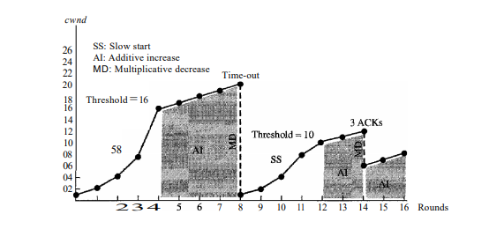

Slide 22
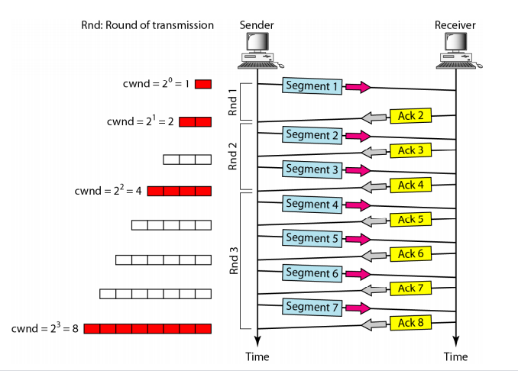
Example :slow start with exponential increase

Slide 23
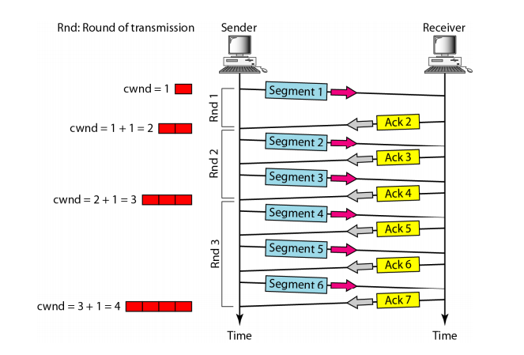
Example :Additive increase

Slide 24
Consider the effect of using slow start on a line with a 10 msec RTT and no congestion. The receiver window is 24 KB and the maximum segment size is 2 KB. How long does it take before the first full window can be sent?
Solution-
Given-
Receiver window size = 24 KB
Maximum Segment Size = 2 KB
RTT = 10 msec
Receiver Window Size-
Receiver window size in terms of MSS
= Receiver window size / Size of 1 MSS
= 24 KB / 2 KB
= 12 MSS
Slow Start Threshold-
Slow start Threshold== Receiver window size / 2
= 12 MSS / 2 = 6 MSS

Slide 25
Slow Start Phase-
Window size at the start of 1st transmission = 1 MSS
Window size at the start of 2nd transmission = 2 MSS
Window size at the start of 3rd transmission = 4 MSS
Window size at the start of 4th transmission = 6 MSS
Since the threshold is reached, so it marks the end of slow start phase.
Now, congestion avoidance phase begins.
Congestion Avoidance Phase-
Window size at the start of 5th transmission = 7 MSS
Window size at the start of 6th transmission = 8 MSS
Window size at the start of 7th transmission = 9 MSS
Window size at the start of 8th transmission = 10 MSS
Window size at the start of 9th transmission = 11 MSS
Window size at the start of 10th transmission = 12 MSS
From here,
Window size at the end of 9th transmission or at the start of 10th transmission is 12 MSS.
Thus, 9 RTT’s will be taken before the first full window can be sent.
So,
Time taken before the first full window is sent
= 9 RTT’s= 9 x 10 msec = 90 msec

Slide 26
Problem 1
In a leaky bucket used to control liquid flow, how many gallons of liquid are left in the bucket if the output rate is 5 gal/min, there is an input burst of 100 gal/min for 12 s, and there is no input for 48 s?
Solution:
The input is 100 gal/min, will be 100/60 = 1.667 gal/sec and 1.667*12 =20 gal in 12 seconds.
The output is 5 gal/min, will be 5/60 = 0.08333 gal/sec
As input continues for 12 seconds, 0.8333 * 12 = 1 gallon will be loss in 12s and 0.8333*48 =4 gallon in 48 second.
1+4 gallon in 1 minute and the remaining liquid will be 20-5= 15 gallons after 1 minute.

Slide 27
References
Computer Networks: A Systems Approach, Larry L. Peterson and Bruce S. Davie, Fifth Edition, The Morgan Kaufmann Series, Elsevier, 2011.
Data Communication and Networking, Behrouz A. Fourozan, McGraw Hill Education, Fifth Edition, 2012

